Slide 1

This Photo by Unknown Author is licensed under CC BY-SA

Slide 2
MEMBERS
TANVIR SINGH ANEJA
SASHANK SETH
ANURAG GUNDAPI
NAVEEN NAGAPPA NAGANURI
GROUP 2

Slide 3
OBJECTIVES
THE MAIN AIM OF THIS PROJECT IS TO CRACK THE SUCCESS FORMULA FOR PROJECTS IN KICKSTARTER AND SHOW OTHER KEY PERFORMANCE INDICATORS.

Slide 4
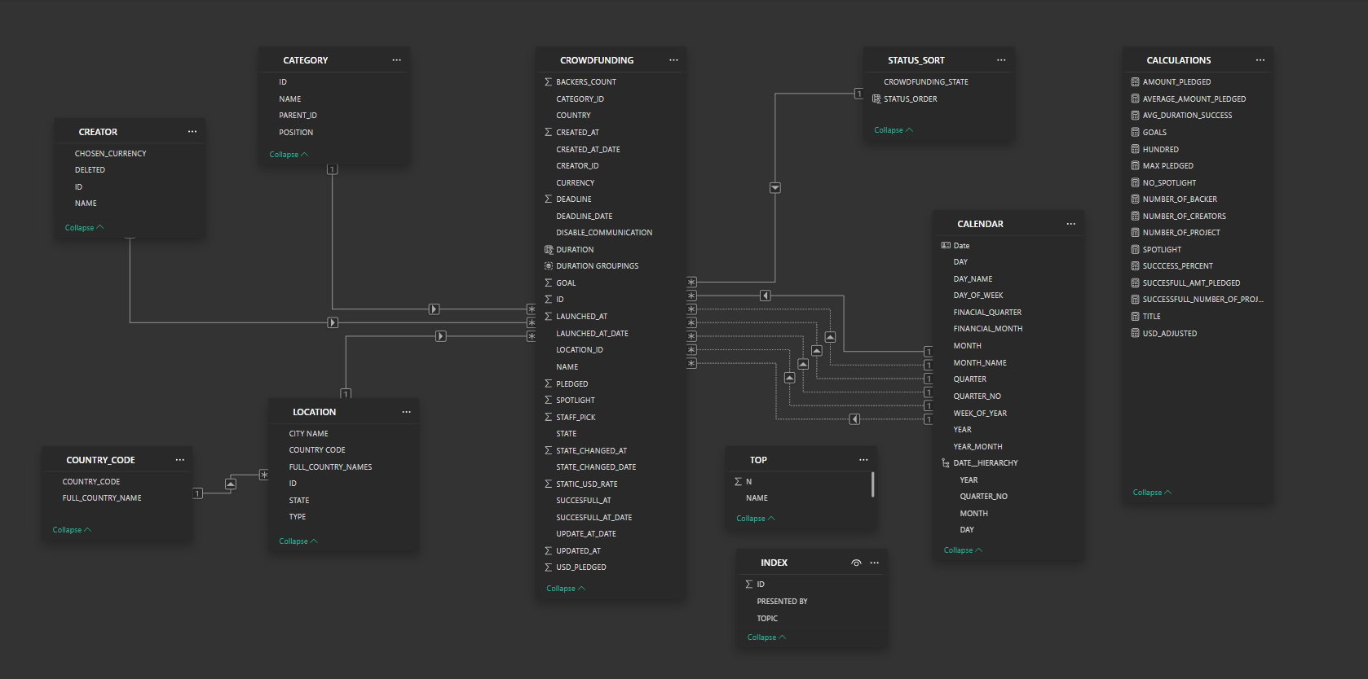
DATA MODELLING

Slide 5
CHALLENGES
VOLUME OF DATA
EPOCH TIME SERIES
TERMINOLOGY
UNCLEAN AND UNSTANDARDISED DATA
Notes:
OVER 3 LAKH RECORD IN 2 TABLE WITH OVER 20 COLUMN AROUND 1 CRORE CELLS OF DATA
THE TIME CONVERSION WAS AN ISSUE
EXPLAINED LATER
VARIOUS COLUMN HAD TRUE FALSE ALONG WITH 1 AND 2, SOME COLUMNS HAD UNCLEAN DATA WITH SYBOLS AND DELETED MENTIONED

Slide 6
KEY PERFORMANCE INDICATOR
NUMBER OF PROJECT
SUCCESSFUL PROJECTS
TOP SUCCESSFUL PROJECTS
PERCENTAGE OF SUCCESS
(BASED ON STATUS, LOCATION, CATEGORY AND YEAR)

Slide 7
TERMINOLOGY
SUCCESSFUL = PROJECTS THAT MET THEIR GOALS
LIVE = PROJECTS THAT ARE STILL COLLECTING MONEY
CANCELLED = PROJECT REMOVED BY CREATOR BEFORE DEADLINE
FAILED = DIDN’T ACHIEVE GOAL WITHIN DEADLINE
SUSPENEDED = TEMPORARILY REMOVED DUE TO VIOLATION OF RULES
PURGED = PERMANENTLY REMOVED DUE TO VIOLATION OF RULES OR FRAUD

Slide 8
TERMINOLOGY
GOAL = THE AMOUNT THAT THEY WANT TO RAISE
PLEDGED = AMOUNT GIVEN BY THE BACKERS FOR THE PROJECT
BLURB = CATCHY DESCRIPTION ADDED TO GRAB ATTENTION
SPOTLIGHT = PROJECT SHOWN ON KICKSTATERS HOME PAGE
STAFF PICK = PROJECT PUT ON HOME PAGE BY KICKSTARTER STAFF
DISABLE COMMUNICATION = WHETHER BACKER CAN COMMUNICATE WITH THE CREATOR

Slide 9
TERMINOLOGY
CREATED AT
WHEN CREATOR MAKE A PAGE ON KICKSTARTER
LAUNCHED AT
WHEN THE PAGE OF THE CREATOR GOES LIVE
UPDATE CHANGED AT
WHEN THE CREATOR MAKES SOME CHANGE IN THE PROJECT
STATE CHANGED AT
SUCCESSFUL AT
WHEN THE STATUS OF THE PROJECT IS CHANGED
WHEN THE PROJECT SUCCEDED IT GOALS BEFORE THE DEADLINE
DEADLINE
WHEN WILL THE BACKING END

Slide 10
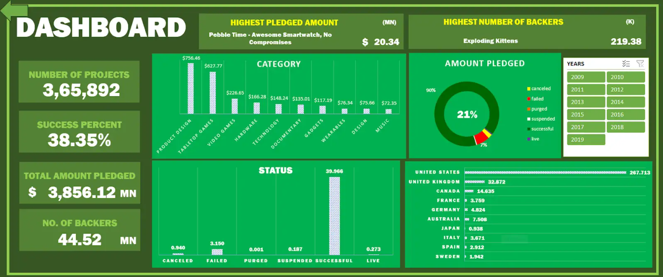
EXCEL
DASHBOARDS
EXCEL
POWER BI
TABLEAU
MY SQL

Slide 11
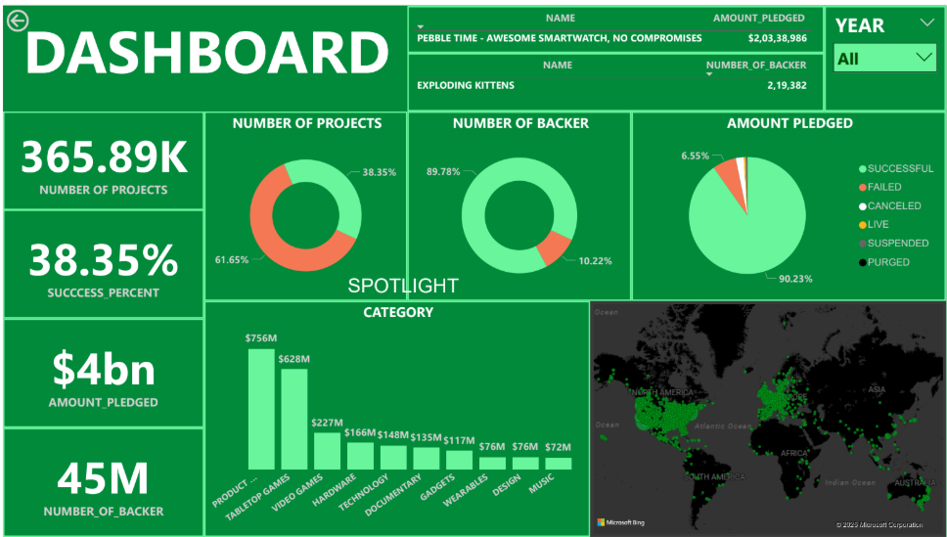
POWER BI
DASHBOARDS
EXCEL
POWER BI
TABLEAU
MY SQL

Slide 12
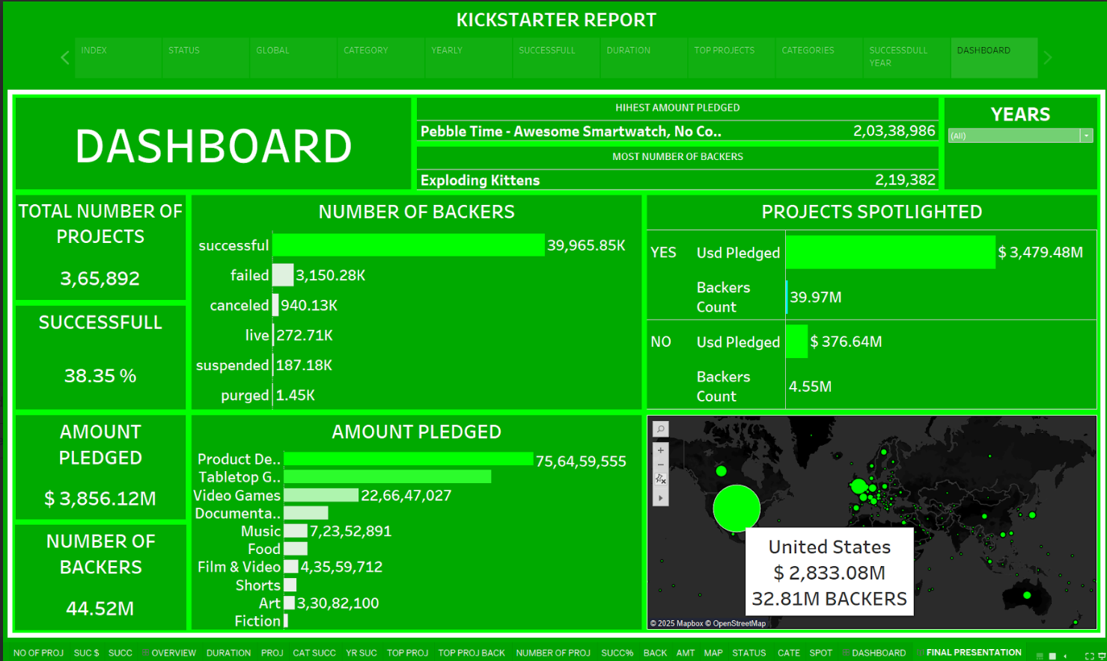
TABLEAU
DASHBOARDS
EXCEL
POWER BI
TABLEAU
MY SQL

Slide 13
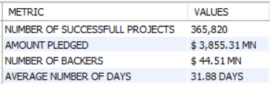

MY SQL
DASHBOARDS
EXCEL
WITH SPOTLIGHT AS( SELECT SUM(USD_PLEDGED) AS USD_PLEDGED, SUM(GOAL) AS GOAL_SET, COUNT(*) AS NUMBER_OF_PROJECTS FROM crowd_funding WHERE SPOTLIGHT =1)
, NO_SPOTLIGHT AS( SELECT SUM(USD_PLEDGED) AS USD_PLEDGED, SUM(GOAL) AS GOAL_SET, COUNT(*) AS NUMBER_OF_PROJECTS FROM crowd_funding WHERE SPOTLIGHT =0)
SELECT 'YES' AS SPOTLIGHT, FORMAT(NUMBER_OF_PROJECTS,0) AS NUMBER_OF_PROJECTS, CONCAT('$ ',FORMAT(ROUND((USD_PLEDGED/1000000),2),0),' MN') AS AMOUNT_PLEDGED,
CONCAT('$ ',FORMAT(ROUND((GOAL_SET/1000000),2),0),' MN') AS GOAL_SET, CONCAT(ROUND((USD_PLEDGED*100/GOAL_SET),2),' %') AS GOAL_PER FROM SPOTLIGHT UNION
SELECT 'NO', FORMAT(NUMBER_OF_PROJECTS,0) AS NUMBER_OF_PROJECTS, CONCAT('$ ',FORMAT(ROUND((USD_PLEDGED/1000000),2),0),' MN') AS AMOUNT_PLEDGED,
CONCAT('$ ',FORMAT(ROUND((GOAL_SET/1000000),2),0),' MN') AS GOAL_SET, CONCAT(ROUND((USD_PLEDGED*100/GOAL_SET),2),' %') AS GOAL_PER FROM NO_SPOTLIGHT;
POWER BI
TABLEAU
SELECT 'NUMBER OF SUCCESSFULL PROJECTS' AS METRIC, FORMAT(COUNT(*),0) AS `VALUES` FROM CROWD_FUNDING UNION
SELECT 'AMOUNT PLEDGED', CONCAT('$ ',FORMAT(ROUND((SUM(USD_PLEDGED)/1000000),2),2),' MN') FROM CROWD_FUNDING UNION
SELECT 'NUMBER OF BACKERS', CONCAT('$ ',FORMAT(ROUND((SUM(BACKERS_COUNT)/1000000),2),2),' MN') FROM CROWD_FUNDING UNION
SELECT 'AVERAGE NUMBER OF DAYS', CONCAT(ROUND(AVG(DATEDIFF(SUCCESSFULL_AT_DATE,LAUNCHED_AT_DATE)),2),' DAYS') FROM CROWD_FUNDING;
MY SQL

Slide 14
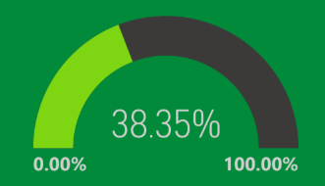
OVERALL
FINDINGS
OVERALL
DURATION
CATEGORY
BIG PLEDGES
SPOTLIGHT
SUCCESSFULL
Notes:
OF ALL THE PROJECT WE OBSERVED THAT MORE THAN 50 % OF THE PROJECTS DIDN’T MEET THERE REQUIRED GOALS. WITH A SUCCESS % OF JUST AROUND 38 % SHOWS THAT MAJORITY PROJECTS PUT ON KICKSTARTER ARE NOT GETTING SUCCESFULL.

Slide 15
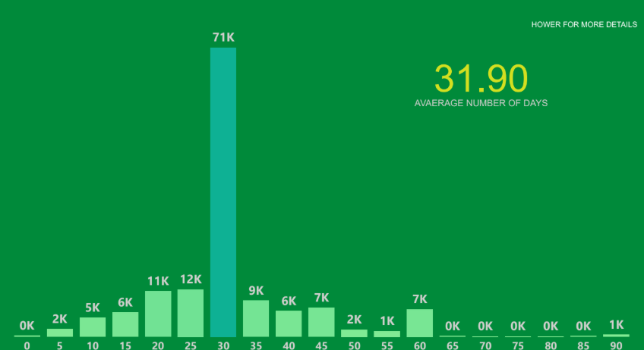


DURATION
FINDINGS
OVERALL
DURATION
CATEGORY
BIG PLEDGES
SPOTLIGHT
SUCCESSFULL
Notes:
THE SWEET SPOT FOR SUCCESS IN 30 DAYS. WE ALSO OBSERVED THAT SUCCESS RATE WAS HIGHER COMPARED TO THE AVERAGE BELOW 30 DAYS AND LOWER COMPARED TO THE AVERAGE AFTER 30 DAYS.

Slide 16

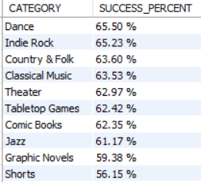




CATEGORY
FINDINGS
OVERALL
DURATION
CATEGORY
BIG PLEDGES
SPOTLIGHT
SUCCESSFULL
Notes:
CREATIVE FIELDS LIKE DANCE, MUSIC, THEARTE HAVE THE HIGHEST SUCCESS RATE COMPARED TO ANY OTHER CATEGORY.

Slide 17




BIG PLEDGES
FINDINGS
OVERALL
DURATION
CATEGORY
BIG PLEDGES
SPOTLIGHT
SUCCESSFULL
Notes:
OF ALL CATEGORIES THE BIGGEST CASH COWS WERE TABELTOP GAME, PRODUCT DESIGN, AND VIDEO GAME HAVING AN AVERAGE PLEDGE AMOUNT IN 5 FIGURES INSPITE OF HAVING OVER 10,000 PORJECTS.

Slide 18
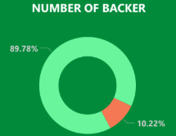
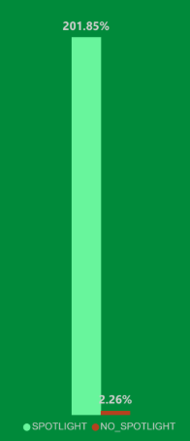
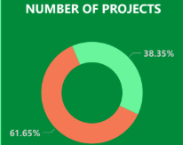
SPOTLIGHT
FINDINGS
OVERALL
DURATION
CATEGORY
BIG PLEDGES
SPOTLIGHT
40% PROJECTS
90% BACKER
90% AMOUNT PLEDGED
202% GOALS ACHEIVED
SUCCESSFULL
Notes:
SPOTLIGHT PROJECTS ARE THOSE WHICH ARE DISPLAYED ON THE HOME PAGE OF KICKSTARTER. THESE PROJECT ARE THE 1ST PROJECTS THAT BACKER WOULD SEE.
INTRESTINGLY ABOUT 40% OF PROJECTS ARE SPOTLIGHTED WHICH IS THE SAME AS THE SUCCESS RATE OF THE PROJECTS, BUT THEY CONTRIBUTE TO AROUND 90 % OF THE NUMBER OF BACKERS. THIS SHOWS THAT THE BACKER USUALLY SUPPORT PROJECT WHICH THEY CAN SEE ON THE HOME PAGE, AS EVIDENT WITH THE COLLECTION WHICH IS 202 % OF THE GOALS SET.

Slide 19


SUCCESSFULL
FINDINGS
OVERALL
DURATION
CATEGORY
BIG PLEDGES
SPOTLIGHT
SUCCESSFULL
Notes:
PEBBLE TECHNOLOGY WAS BY FAR THE MOST DOMINANT FORCE IN KICKSTARTER WITH OVER 3 PROJECT RACKING UP OVER 10 MILLION DOLLARS.

Slide 20
THANK YOU

